Slide 1
INVESTMENTS
Week 1: INSTRUMENTS AND MARKETS
Vikas Raman

Slide 2
Investments?
Investments or Investment Management involves ...
constructing the portfolio of assets that best matches the investor’s preferences and needs
evaluating the performance of this portfolio
adjusting the composition of the portfolio, as necessary
More strategic than Security Analysis which aims to determine whether individual securities are correctly priced or not

Slide 3
Asset Allocation
The first problem in Portfolio Management is Asset Allocation
how much of an investor’s wealth should be invested in each of the following broad areas:
Cash ,equities, bonds, derivative securities
Private equity, hedge funds, commodities, and real estate
We will focus on the first four, though analysis is relevant to all

Slide 4
Investment strategies
Passive Management
“buy and hold” a well-diversified portfolio of assets
Active Management
Security selection attempts to identify securities that have been mis-priced
“buy low / sell high”
Market timing tilts the portfolio composition in favour of (away from) equities when the investor is “bullish” (“bearish”) about the Stock Market
Portfolio Insurance
use derivatives to “manage risk”

Slide 5
Purpose of the Course
Familiarity with terminology, players, institutions
Understanding of risk and the trade-off between risk and return
How to allocate portfolio between different types of assets
How to construct an efficient portfolio of equities and bonds
How to manage a portfolio over time and to use derivatives effectively
To increase your appetite to learn more about the area

Slide 6
Nature of Module
World is a messy, complex place
Need to make sense of what we see
Learn to
think more precisely about what we observe
develop models to interpret what we see
test the models critically for coherence and consistency
confront the models with the data
Economics is not physics
need to use many models, decide which are helpful
simplification is key – but what are details and what is crucial?

Slide 7
Synopsis
Objectives
Assessment
Assignments
Workshops
Material
Recommended books
Communication

Slide 8
Course outline
1. Financial instruments and markets
2. Diversification and Portfolio Theory
3. Asset Pricing Models
4. Empirical Analysis of Security Returns
5. Market Efficiency
6. Portfolio performance measurement
7-8 Fixed-income securities
9-10. Hedge Funds;
topical topics or issues that are of particular concern to the class

Slide 9
Financial Instruments
Financial security
legal contract
confers the right to receive future benefits
will focus on traded securities (not bank debt) that can be priced continuously
usually traded in organised markets
Classification
cash product vs. derivative security
debt vs. equity
Sub-classification of debt
by issuer
by maturity

Slide 10
Money Market Securities
Short-term (less than 1 year) debt
Issued by Governments or Companies
Examples include
Treasury Bills
Repurchase Agreements (REPOs)
Certificates of Deposit
Commercial Paper

Slide 11
T-Bills
Issued by the Government: no risk of default
Short-term securities: little inflation risk
Highly liquid
Sold at a discount to face value: “zero-coupon” bonds

Slide 12
REPOs
Agreement to sell and re-purchase securities
Example: Hedge Fund wants to buy some shares but has no cash. Holding £10m market value of bonds which it wants to keep. Agrees to sell to Bank for £10m, and buy same bonds back in 1 week for £10.008m in 1 week
Hedge fund effectively borrowing at .008x52/10 = 4.16%
REPOs are collateralised debt, and provide cheap financing
If hedge fund goes bust, Bank can sell the bonds
Bank’s credit risk limited to fall in value of bonds over the week
credit risk can be mitigated by over-collateralising – eg getting a loan of only £9.5m on £10m of mortgages

Slide 13
Reverse REPOs
From Bank’s perspective, the deal is a reverse repo:
getting the bonds from an investor, and promising to return them in a week’s time
lending money at 4.16% per annum
secured lending

Slide 14
LIBOR
London Inter-Bank Offer Rate
rate at which London-based banks lend to each other without collateral
comparable rates in other markets
range of maturities from overnight to annual
range of currencies
based on poll of banks at 11.00am each day
indicative rate: bank A may be unwilling to lend to bank B at this rate because of credit issues
The British Bankers Association used to administer the LIBOR, but after the scandal → Financial Conduct Authority (U.K)
Key reference rate
Over $10 trillion in corporate loans, floating rate notes, adjustable rate residential mortgages etc., are pegged to LIBOR.
Also, LIBOR is the key rate in the $350 trillion market for interest rate swaps.

Slide 15
The Credit Crunch

Slide 16
LIBOR Scandal
“Major banks are contributing to the erratic behaviour of a crucial global lending benchmark...” (WSJ, May 2008)
Some banks might have understated borrowing costs they reported for the Libor during the 2008 credit crunch (WSJ, May 2008)
On 27 June 2012, Barclays Bank was fined ~$450 million by regulators in the US and the UK
Marcus Agius (chairman) and Bob Diamond (CEO) resigned from there position
Why would banks understate LIBOR?

Slide 17
Commercial Paper
Issued by large companies as an alternative to borrowing directly from a bank
Usually short -term (< 3 months) issue
Reasonably safe investment since the issuing company’s financial condition can usually be monitored over such a short period of time
Common for companies to “roll over” the debt by issuing new CP when the original CP matures

Slide 18
Capital Market Securities
Maturities greater than 1 year
Debt (“Fixed Income”) vs. Equity

Slide 19
Fixed Income Securities
Promised stream of future cash flows
fixed interest payments (“coupons”)
fixed dates for coupon payments and repayment of principal
Failure to meet a coupon payment immediately puts the bond into default
Issued by Governments and Companies

Slide 20
Index-linked Bonds
Coupon and principal repayment fixed in real terms
typically payments are indexed to specified inflation index such as the RPI in the UK
may be a lag between index date and payment date (eight months in UK) which makes indexation imperfect
Mainly issued by Governments
first issue was in UK in 1981
Substantial issues also in US (“TIPS”), France, Australia, Canada, Sweden

Slide 21
Equity
Residual claim on the assets and earnings of a company
last to be paid in liquidation
carries ownership rights (right to appoint directors, approve auditors, approve certain major changes)
generally one share one vote
protection of minorities
Entitled to dividends
Limited liability
if company goes bankrupt, investor’s loss is limited to original stake in the company

Slide 22
Derivative Securities
Value derived from the value of some underlying asset (equity, bonds, currencies, ...)
Futures, Options, Swaps, ...
Options are side-bets on the performance of individual securities
buying/selling options on a particular stock does not affect that company’s cashflows
no change in the number or type of outstanding securities
Companies can issue their own contingent claims
rights issues, warrants, convertibles, ...
if these options are exercised, company attributes (such as the number of outstanding shares) change

Slide 23
Indirect Investment
Direct ownership of shares may be costly
Record keeping
Diversification
Fixed costs of research and professional maangement
Economies in transacting
Investment Companies manage a portfolio of securities and charge a fee
“open-end” funds (mutual funds, OIEC or unit trust)
“closed-end” funds (Investment Trusts)

Slide 24
“Open-end” Funds
“Units” are bought from / sold to the Mutual Fund directly (in EU: OEIC “open-ended investment company”)
“Units” are bought/sold at the net asset value of the Fund, which is determined daily
Fund Manager may charge a fee when the investor buys (“front-end load”) and/or sells (“back-end load”), plus a management fee
Scope of fund and objectives laid down

Slide 25
“Closed-end” Funds
Pre-determined number of shares in the Fund issued initially
Net proceeds of sale of these shares is invested in equities and/or bonds
Shares in the Fund are traded on an Exchange continuously
Owning shares in a “closed-end” fund is similar to owning shares in a company, except ...
the assets of the “company” are the equities and bonds which the Fund owns
Unlike “open-end” funds, shares in a “closed-end” fund can sell at a premium or discount to the net asset value

Slide 26
Exchange Traded Funds (ETFs)
Like a mutual fund in that it is an open ended fund with daily creation, cancellation of units as funds flow in and out
But traded on an exchange, so can trade at any time without a front end or back end load (though have to pay bid-ask spread and commission)
Typically designed to track an index

Slide 27
Hedge Funds
Typically structured as private partnerships and subject to much less regulation than mutual funds
fee structure often “2+20” (2% of assets per annum, plus 20% of gains)
tend to outsource most of administration and some execution, buying broker research through commission
often targets relative mispricing, buying cheap asset, short selling expensive asset, and leveraging position
successful funds often close to new money
lock up period makes investment illiquid, and makes it possible for fund to hold illiquid investments

Slide 28
Short Sale Diagram
Sells shares in market @ £S
Initial Transaction
Borrows shares
Short Seller
Lender
Proceeds
Final Transaction
Buy shares in market @ £B
Returns Shares
Short Seller
Lender
Proceeds
Short Seller’s Profit : £(S-B)

Slide 29
Buying on Margin
Borrow cash from broker (Leverage)
Initial Margin = Own Investment / Value of Stock in Account
Maintenance Margin = Equity / Value of Stock in Account
Margin Call: Margin < Maintenance level
Add cash or close out

Slide 30
Buying on Margin: Example 1
Initial margin = 50%
Maintenance margin = 30%
Margin loan rate = 8%
Stock price P₀ = £100 per share
Order size: 200 shares of stock

Slide 31
Buying on Margin: Example 1 (Continued)
Scenario | Price | Value of Stock in Account | Liability (Value of borrowed cash) | Equity (=Account Value less Liability) | Stock return | Your return | Margin
Initial position | P₀=100 | £20,000 | £10,000 | £10,000 initial own investment | n/a | n/a | 50%
After one year, GOOD | P₁=130 | £26,000 | £10,800 | £15,200 | + 30% | + 52% | 58%
After one year, NORMAL | P₁=100 | £20,000 | £10,800 | £9,200 | 0 % | - 8% | 46%
After one year, BAD | P₁=70 | £14,000 | £10,800 | £3,200 | - 30% | - 68% | 23% CALL !!

Slide 32

Buying on Margin: Example 1 (Continued)
How low can the price drop before you receive a margin call?
30% = $\frac{\text{[200*}\text{P}\text{-10,800] }}{\text{200*}\text{P}}$
P = £77.14

Slide 33
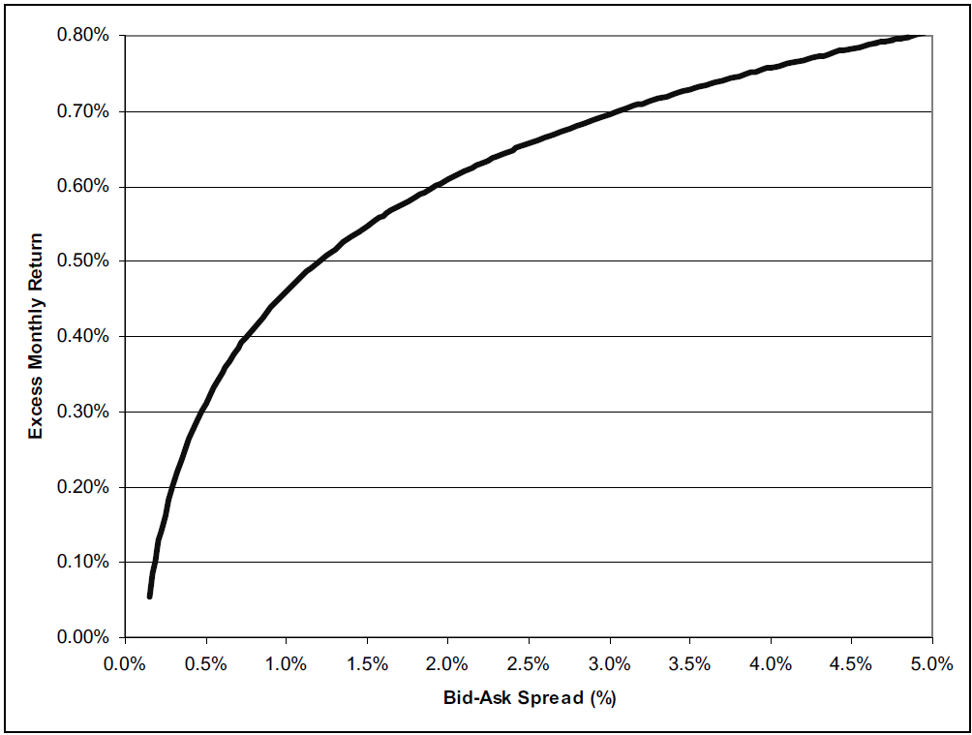
Financial Markets
Liquidity is key
to serve needs of investors, must be easy to buy or sell at short notice without moving the price a lot
illiquidity reduces value of securities, increases required return and cost of capital
Car with an active resale market is more valuable than one without (all else equal)!
Relationship between stocks’ excess monthly returns and bid–ask spreads for a given level of (systematic) risk (Amihud, Mendelson and Pedersen, 2005).

Slide 34
What we have done
Terminology
Instruments (fixed income, equity)
Some description
Introduced concepts
Short selling
Margin Trading
Information and Liquidity
Risk and return
See BKM Chs 1-4: get comfortable with institutions, instruments, mechanisms

Slide 35
Exercise for next week
Get price series for 5 stocks for 52 weeks, and for suitable market index
ideally want corrected for dividends, splits etc
Compute mean and standard deviation of weekly returns, and correlations between returns across stocks
Plot returns against returns on index (scattergram) and get correlation and line of best fit (regression)
Form portfolios where you keep constant percentage weights over time
compute portfolio mean return and standard deviation, and correlation with index
Write up and comment on your results

Slide 36
Quick Refresher – Average and Std. Deviation
If P_{t} is the price at the beginning of period t, then the return over period t is r_{t} = (P_{t}+1/P_{t}) – 1
Given returns over periods 1 to N, the average return per period is:
The (sample) standard deviation of returns is:

Slide 37
Quick Refresher – Covariance and Correlation
Given one stock R which has return r_{t} and another S which has return s_{t}, the covariance of R’s return with S is:
The correlation of R’s return with S is:

Slide 38

Quick Refresher – Important Properties
Some important properties:
$E\left(aX\right)=aE\left(X\right)$
$E\left(aX+b\right)=aE\left(X\right)+b$
$Var\left(aX\right)=a^{2}Var\left(X\right)$
$Var\left(aX+b\right)=a^{2}Var\left(X\right)$

Slide 39
Quick Refresher– Important Properties
Example
A random variable X takes the value of 0 with probability of 0.5, 1 with probability of 0.3, and 2 with a probability of 0.2
Calculate E(X), E(3X+3), E(X² ), Var(X), Var(3x), and Var(3x+3)

Slide 40
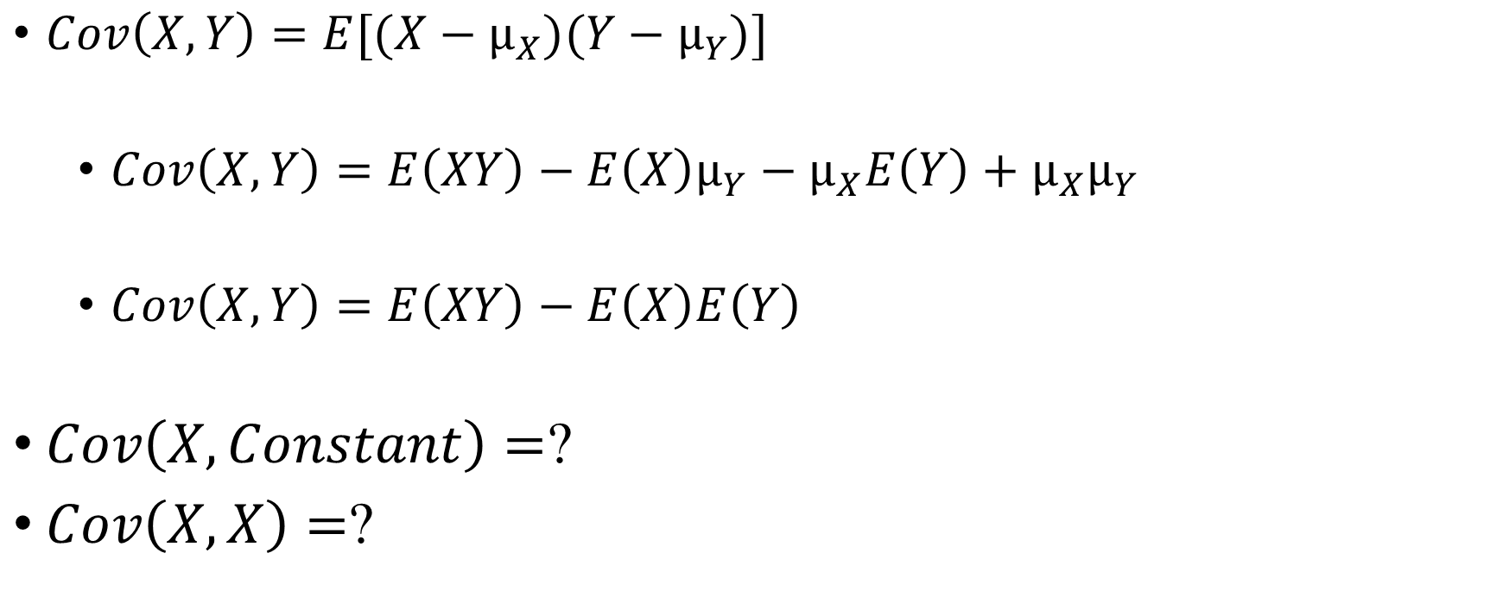
Quick Refresher– Important Properties
$Cov\left(X,Y\right)=E[(X−µ_{X})(Y−µ_{Y})]$
$Cov\left(X,Y\right)=E\left(XY\right)−E\left(X\right)µ_{Y}−µ_{X}E\left(Y\right)+µ_{X}µ_{Y}$
$Cov\left(X,Y\right)=E\left(XY\right)−E\left(X\right)E\left(Y\right)$
$Cov\left(X,Constant\right)=$?
$Cov\left(X,X\right)=$?

Slide 41
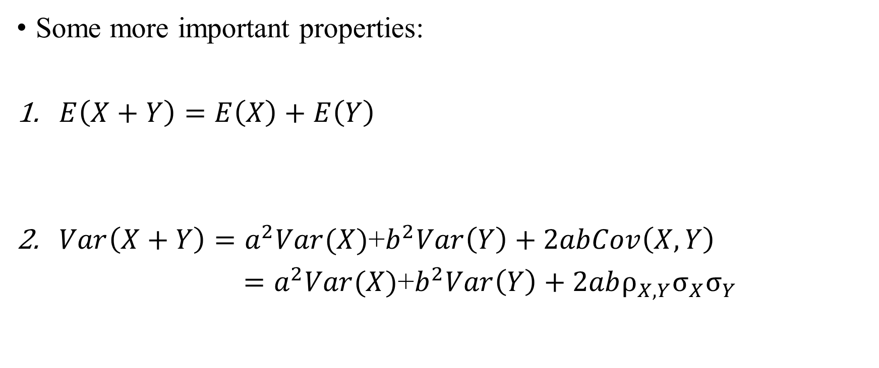
Quick Refresher – Important Properties
Some more important properties:
$E\left(X+Y\right)=E\left(X\right)+E\left(Y\right)$
$Var\left(X+Y\right)=a^{2}Var(X)$+$b^{2}Var\left(Y\right)+2abCov\left(X,Y\right)$
$=a^{2}Var(X)$+$b^{2}Var\left(Y\right)+2ab{ρ_{X,Y}σ}_{X}σ_{Y}$

Slide 42
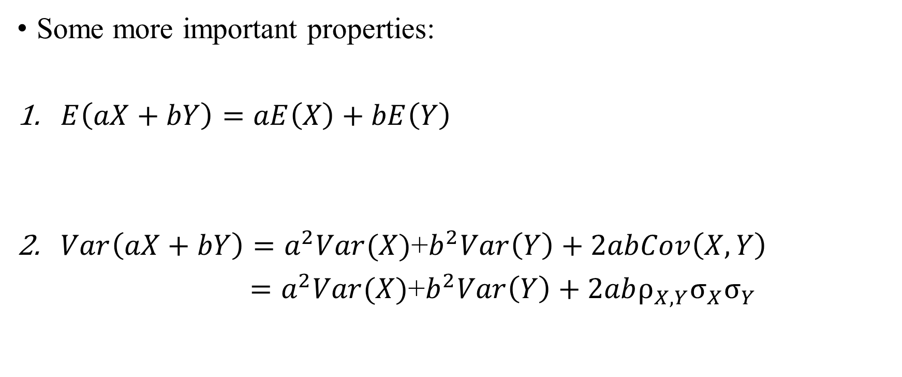
Quick Refresher– Important Properties
Some more important properties:
$E\left(aX+bY\right)=aE\left(X\right)+bE\left(Y\right)$
$Var\left(aX+bY\right)=a^{2}Var(X)$+$b^{2}Var\left(Y\right)+2abCov\left(X,Y\right)$
$=a^{2}Var(X)$+$b^{2}Var\left(Y\right)+2ab{ρ_{X,Y}σ}_{X}σ_{Y}$

